Slide 1
JLN System Overview

Slide 2
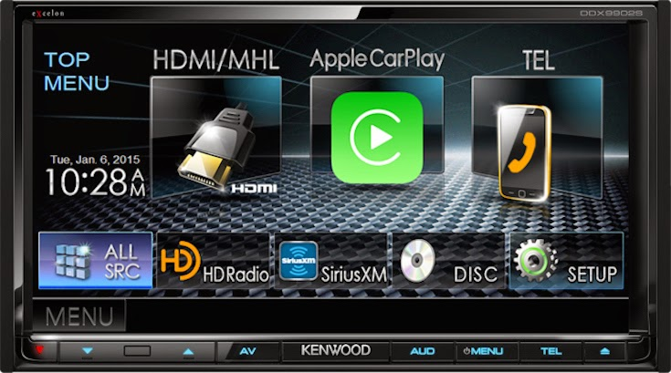
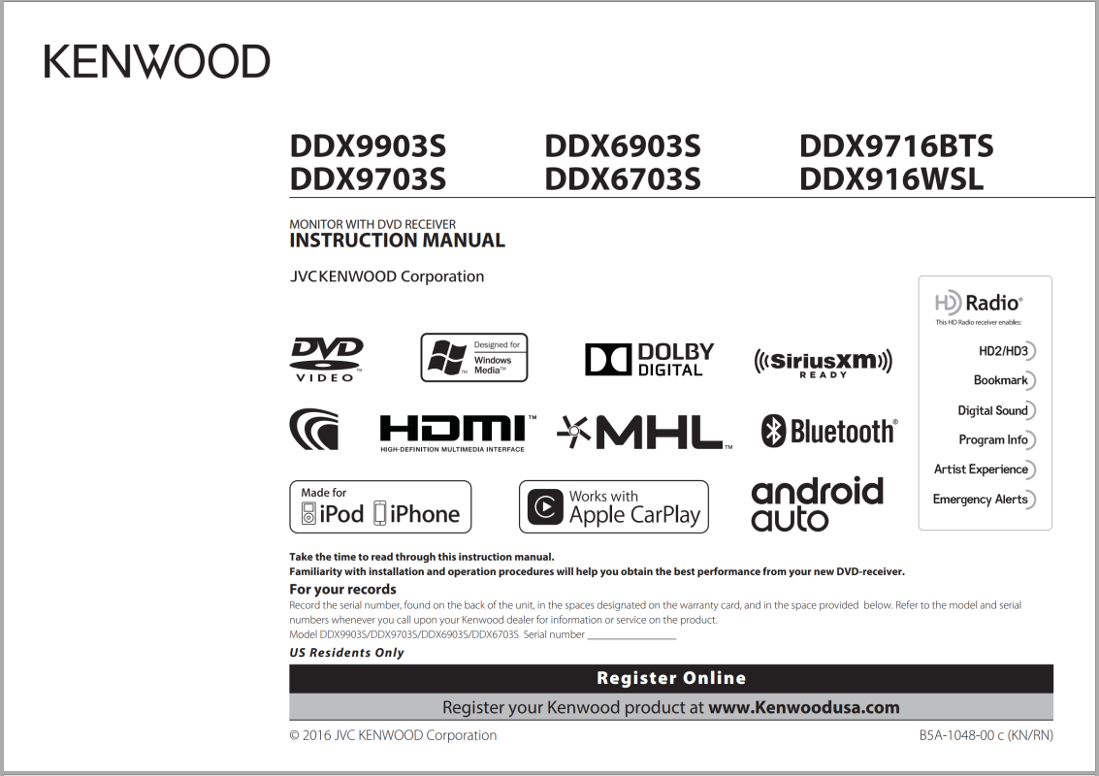
JVC Kenwood Head Unit
B5A-1048-00c_K_EN.pdf

Slide 3
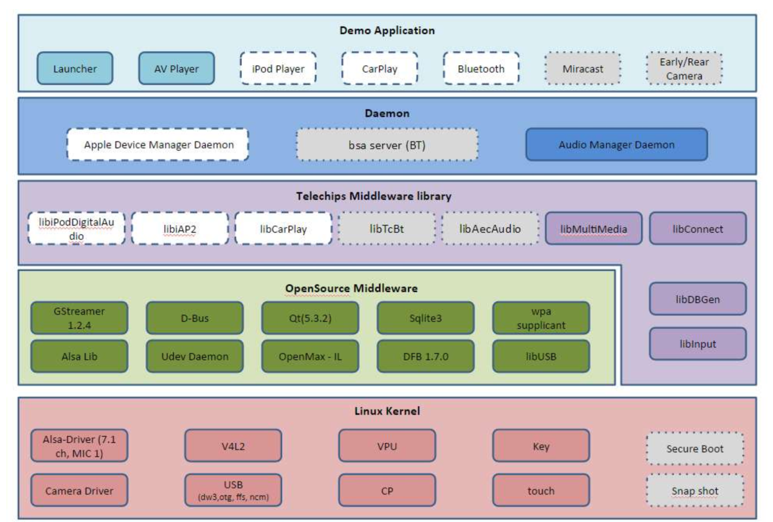
System Overview
LK
JK App, daemon
JK Libs
JK Specific Driver, Config…
Hardware

Slide 4
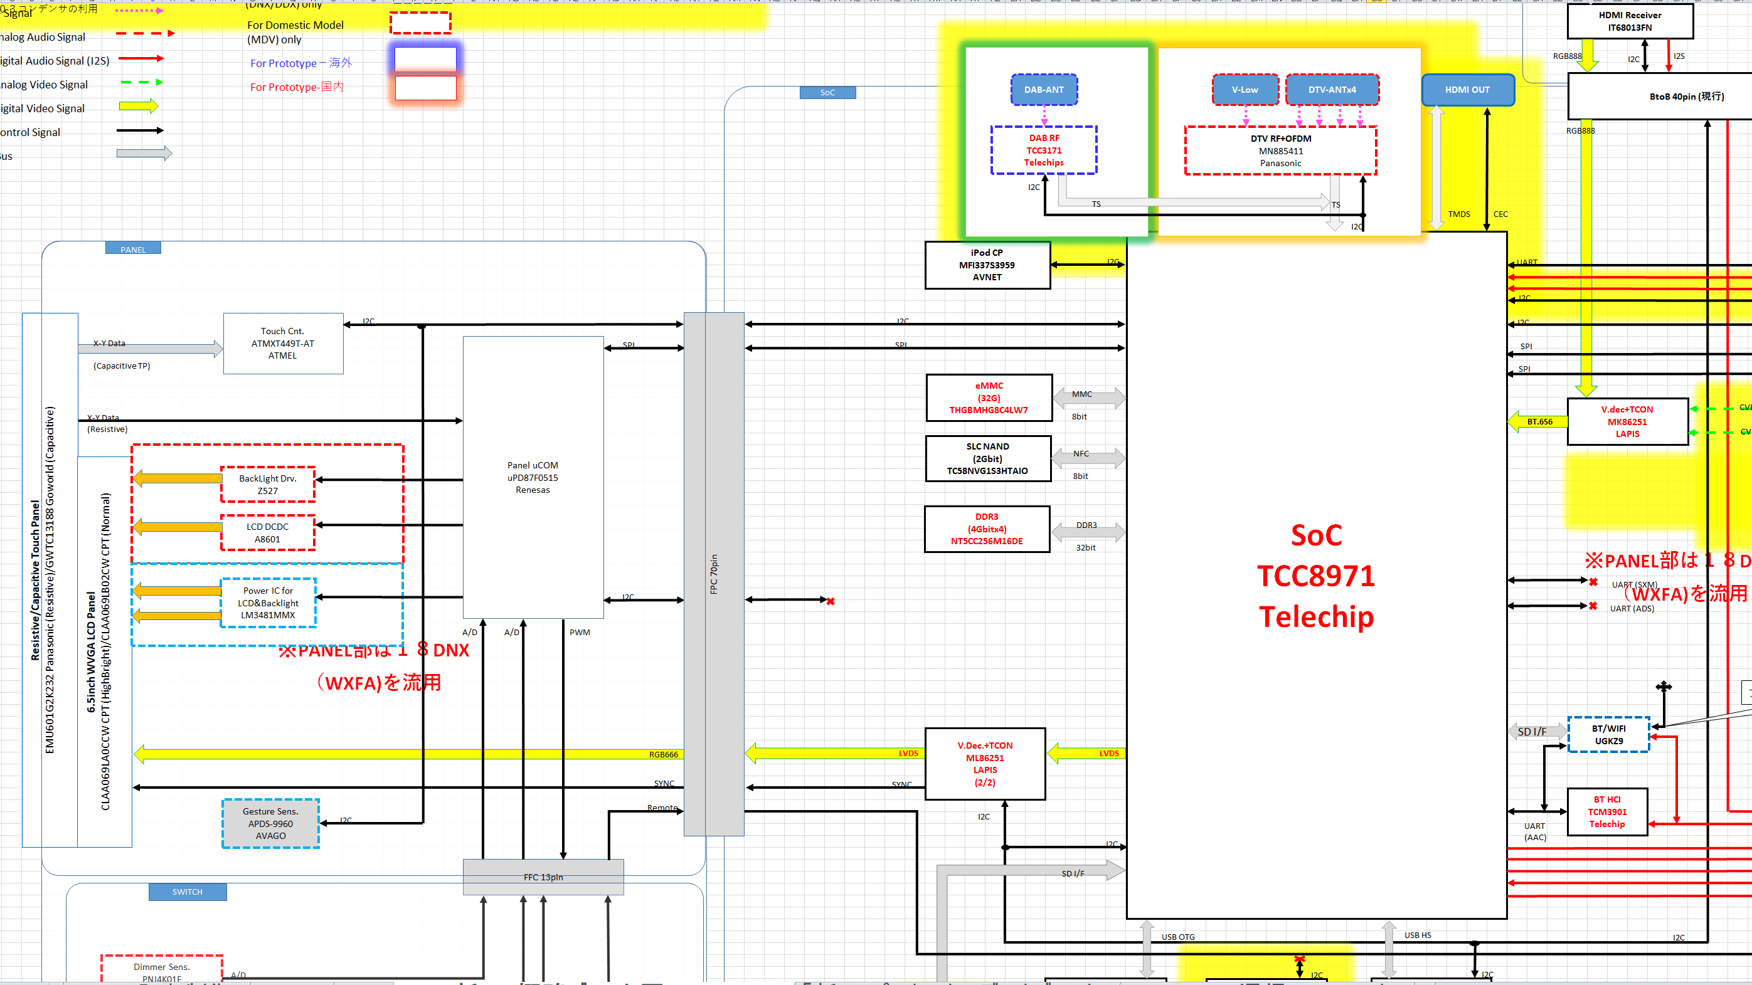
Hardware
TCC897x検討資料_18Model.xlsx

Slide 5
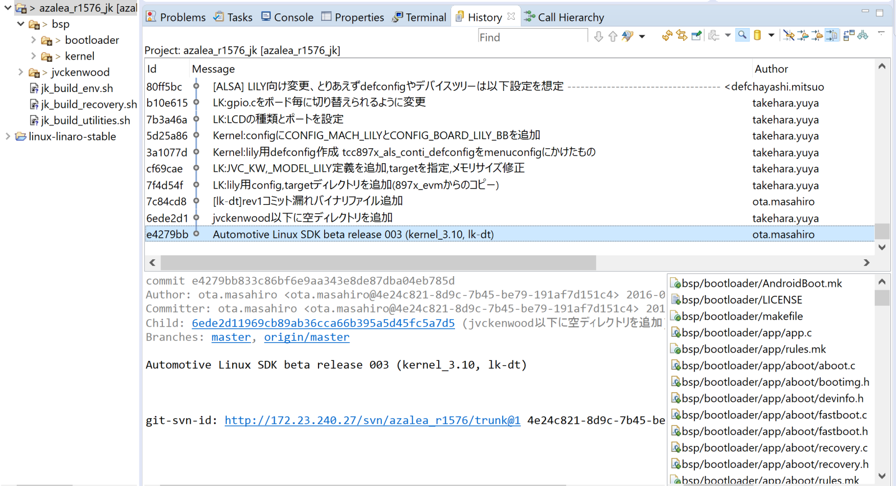
Software

Slide 6

TC SDK Release
LK
Hardware

Slide 7
LK Modification & Addition
LK
Hardware

Slide 8
Kernel Modification & Addition
LK
JK Specific Driver
Hardware

Slide 9
User space Modification & Addition
LK
JK App, daemon
JK Lib
JK Specific Driver
Hardware

Slide 10
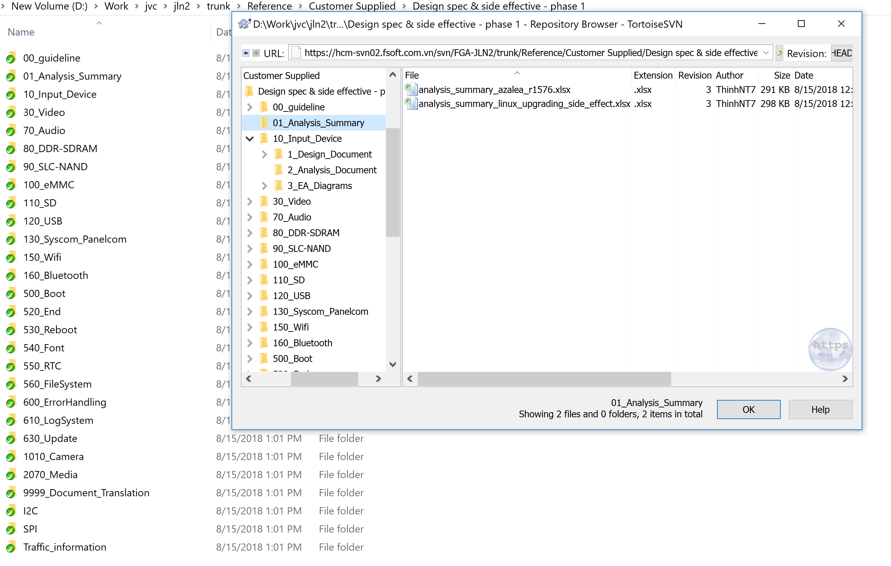
Last project output (JLN)
https://hcm-svn02.fsoft.com.vn/svn/FGA-JLN2/trunk/Reference/Customer Supplied/Design spec & side effective - phase 1/

Slide 11
System Startup

Slide 12
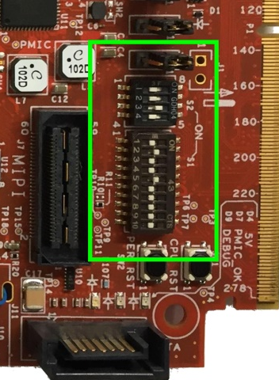
System Startup – Booting Configuration
SoC
TCC8974
Telechip
MMC
8bit
eMMC (32G)
BM[3:0],
GPIOF[24],
GPIOF[25]
Boot Mode
NFC
8bit
SLC NAND (2Gbit)
DDR3
32bit
DDR3
(4Gbitx4)
BM[3:0] | Mode
 | Serial Flash Boot (Serial EEPROM Boot) Mode
 | USB Function Boot Mode
 | SDMMC Boot Mode
 | NOR Boot Mode
0000b | NAND Flash Boot Mode
SRAM (128KB)
Internal Boot ROM

Slide 13
System Startup – Booting Steps
Start
Start
Start
Minimal clock, memory, peripheral initialization
Load First Stage Bootloader into SRAM
Jump to SRAM code
Boot Rom
Boot Rom
First Stage Boot
First Stage Bootloader
LK
Kernel
User space

Slide 14
System Startup – Boot ROM
Start
SoC
TCC8974
Telechip
MMC
8bit
eMMC (32G)
Read Golden Info
NFC
8bit
SLC NAND (2Gbit)
First Stage Bootloader
Check Signature & CRC
DDR3
32bit
DDR3
(4Gbitx4)
Read BootLoader
SRAM (128KB)
First Stage Bootloader
CRC Check & Start BootLoader
Internal Boot ROM

Slide 15
System Start Up – First State Bootloader
SoC
TCC8974
Telechip
MMC
8bit
eMMC (32G)
NFC
8bit
SLC NAND (2Gbit)
LK
DDR3 (4Gbitx4)
LK
DDR3
32bit
SRAM (128KB)
Internal Boot ROM

Slide 16
System Start Up – LK: arch/arm/crt0.S: _start
_start:
Jump to reset: b reset
Init SOC: Init_SoCs
Remap 0x00000000 to SRAM
Copy sram_boot & reset_arm_timer codes to SRAM_BOOT_ADDR (0xF0000000)
Calling reset arm timer code
Setup cache coherency (local_coherency?)
Setup cpu (new thumb behavior, low exception vectors, i/d cache disable, mmu disabled, enable alignment faults…)
Relocate if necessary
Set up stack
Copy the initialized data segment out of rom if necessary
Call kmain

Slide 17
System Startup – LK: kernel/main.c: kmain()
thread_init_early(): Initialize threading system
arch_early_init()
platform_early_init()
target_early_init()
call_constructors()
heap_init()
thread_init()
dpc_init()
timer_init()
Bootstrap2()

Slide 18
System Startup – LK: kernel/main.c: bootstrap2()
arch_init()
platform_init()
target_early_init2()
edi_init()
emmc_boot_main()
SD_BUS_Initialize()
read_partition_tlb()
read_boot_MBR()
read_boot_GPT()
BootInfo_Init(boot_info)
LoadConfig(boot_info); // read configuration:
ptn_index = partition_get_index("share") // read from share partition
ptn_index = partition_get_index("display"); // read from display partition
IQA setting
Get_ModelCode(pModel_code)
index = partition_get_index("model")

Slide 19
System Startup – LK: kernel/main.c: bootstrap2()
T_COM_init()
T_COM_image_adjustment(boot_info, pModel_code)
display_early_init()
fb_config = lcdc_init();
Init LCD pannel: panel_info->init(panel_info)
Display opening image: tcclcd_image_ch_set(panel_info->dev.lcdc_num, &Image_info);
tcc_camera_init(boot_info)
tcc_camera_set_gpio()
tcc_camera_sensor_open()
setEarlyCameraParam(boot_info)
setIQAParam(boot_info)
msc_panel_com_eboot(boot_info, pModel_code);
msc_panel_com_color(boot_info, pModel_code)
start_early_cam()
startCM4_preview()
CM_LoadBinary(CM4_earlycam, sizeof(CM4_earlycam))
CM_MailBox_Configure()

Slide 20
System Startup – LK: kernel/main.c: bootstrap2()
target_init()
display_init()
splash_image_load_jvckw("bootlogo_480x272", fb_config);
ptn_index = partition_get_index(“picdata”);
display_splash_logo(fb_config);
lcdc_set_logo(panel_info->dev.lcdc_num, panel_info->xres, panel_info->yres, fb_con);
gpio_set(LCD_MUTE , 0 ); // Enable LCD video output
update_LK_img(boot_info); // Read LK image from SD or EMMC and write to NAND
unzip_update_img(boot_info); //
msc_main_com(boot_info, pModel_code);
UpdateUcomInfo();
apps_init()
start_app(app);

Slide 21
System Startup – LK: app/aboot/aboot.c
aboot_init
fast_boot_start
aboot_factory_reset
fwdn_start
boot_linux_from_storage()
boot_linux_none_secure()
Read image header
Load kernel
boot_linux((void *)hdr->kernel_addr, (void *)hdr->tags_addr,
(const char *)hdr->cmdline, board_machtype(), // #define LINUX_MACHTYPE 5014
(void *)hdr->ramdisk_addr, hdr->ramdisk_size)
Update command line
Update device tree
Memory
Bootargs
linux,initrd-start
linux,initrd-end
viomg_update_device_tree
entry(0, machtype, (unsigned*)tags_phys)
https://jsevy.com/linux/ARM_Linux_boot_sequence.html
Boot mode select

Slide 22
System Startup – Booting Memory Layout
DDR
dtb
48M
hdr->tags_addr
DTB_ADDR (BASE_ADDR+0X03000000)
page_size
header
initramfs
hdr->ramdisk_addr
RAMDISK_ADDR BASE_ADDR+0X01000000
16M
Compressed kernel
kernel_size
Compressed kernel
32K
hdr->kernel_addr
KERNEL_ADDR (BASE_ADDR+0X00008000)
initramfs
BASE_ADDR (0X80000000 – 2G)
Boot image
SRAM
1st Bootloader

Slide 23
System Startup – System partition
EMMC
SLOT#3
SD
SLOT_TYPE_3
SLOT_ATTR_UPDATE
share
SLOT#2
EMMC
SLOT_TYPE_2
display
SLOT_ATTR_BOOT
model
SLOT#0
SDIO
picdata
NFC
boot
SLC NAND
recovery
dtb
rootfs

Slide 24
System Startup - Kernel Decompress: arch/arm/boot/compressed/head.S
mov r7, r1 @ save architecture ID
mov r8, r2 @ save atags pointer
ldr r4, =zreladdr @ kernel entry point physical address
Do relocation, setup stack, heap for decompression code
bl decompress_kernel
mov r1, r7 @ restore architecture number
mov r2, r8 @ restore atags pointer
b __enter_kernel
mov r0, #0 @ must be 0
ARM( mov pc, r4) @ call kernel

Slide 25
System Startup - Kernel Initialization: arch/arm/kernel/head.S
__lookup_processor_type
__vet_atags
__fixup_smp
__fixup_pv_table
__create_page_tables: Setup initial page table
__cpu_flush
__enable_mmu
__mmap_switched
start_kernel
setup_arch(&command_line)
…
unflatten_device_tree();
mdesc->init_early()
…

Slide 26
System Startup – Kernel Initialization: kernel/init/main.c rest_init()
kernel_thread(kernel_init, NULL, CLONE_FS) // PID 1
pid = kernel_thread(kthreadd, NULL, CLONE_FS | CLONE_FILES) // PID 2
init_idle_bootup_task(current)
cpu_startup_entry(CPUHP_ONLINE)
cpu_idle_loop()

Slide 27
System Startup – Kernel Initialization: kernel/init/main.c: kernel_init()
kernel_init_freeable()
smp_prepare_cpus(setup_max_cpus)
do_pre_smp_initcalls() // => early_initcall
smp_init() // kernel/smp.c
idle_threads_init() // init idle thread for each cpu
cpu_up(cpu) // kernel/cpu.c
__cpu_up(cpu, idle) // arch/arm/kernel/smp.c
ret = smp_ops.smp_boot_secondary(cpu, idle)
tcc_boot_secondary // arch/arm/mach-tcc897x/platsmp.c
tcc_secondary_startup // arch/arm/mach-tcc897x/headsmp.S
secondary_startup
secondary_start_kernel // arch/arm/kernel/smp.c
smp_ops.smp_secondary_init(cpu)
cpu_startup_entry(CPUHP_ONLINE)
sched_init_smp()
do_basic_setup()
devtmpfs_init();
register_filesystem(&dev_fs_type);
thread = kthread_run(devtmpfsd, &err, "kdevtmpfs");
sys_mount("devtmpfs", "/", "devtmpfs", MS_SILENT, options);
sys_chdir("/..")
sys_chroot(".")
driver_init();
do_initcalls();
run_init_process(execute_command)
bsp/kernel/init/initramfs.c
rootfs_initcall(populate_rootfs);
bsp/kernel/init/main.c
/**
* module_init() - driver initialization entry point
* @x: function to be run at kernel boot time or module insertion
*
* module_init() will either be called during do_initcalls() (if
* builtin) or at module insertion time (if a module). There can only
* be one per module.
*/
#define __initcall(fn) device_initcall(fn)
#define module_init(x) __initcall(x);

Slide 28
Init process: initramfs-telechips-image-tcc897x/init
Find real system partition (SYSTEM_PARTITION)
Mount real rootfs
$MKDIR -p /switch_root
$MOUNT $SYSTEM_PARTITION /switch_root
exec $SWITCH_ROOT /switch_root /sbin/init

